Slide 1
FLOOD PREDICTION USING AI MODEL

Slide 2
ABSTRACT
Floods are among the most destructive natural disasters, which are highly complex to model. The research on the advancement of ﬂood prediction models contributed to risk reduction, policy suggestion, minimization of the loss of human life, and reduction the property damage associated with ﬂoods.
To mimic the complex mathematical expressions of physical processes of ﬂoods, during the past two decades, neural network methods contributed highly in the advancement of prediction systems providing better performance and cost-effective solutions.
To prevent this problem to predict flood happen or not by rainfall dataset with investigate the neural network based techniques. The analysis of dataset by Multi-Layer Perceptron Classifier (MLP) to capture several information’s like, variable identification, missing value treatments, data validation and data cleaning/preparing will be done on the entire given dataset.
To performance in prediction of flood happen or not by accuracy calculation with evaluation classification report, identify the confusion matrix and the result shows that the effectiveness of the python framework flask based application by given attributes.

Slide 3
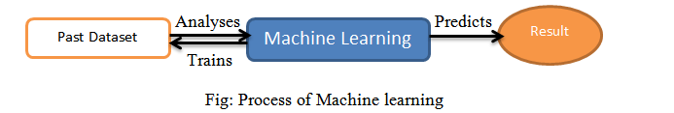
Domain overview
Machine learning is a type of artificial intelligence (AI) that provides computers with the ability to learn without being explicitly programmed. Machine learning focuses on the development of Computer Programs that can change when exposed to new data.

Slide 4
Existing System:
Early classification of ongoing alarm floods in industrial monitoring systems is crucial to provide a safe and efficient operation. It can provide online decision support for plant operators to take timely action, without waiting for the end of an alarm flood. In this article, a data-driven approach is proposed to address the early classification problem with unlabeled historical data.
To prioritize earlier activated alarms and take advantage of the triggering time information of alarms, a vector representation called exponentially attenuated component (EAC) is used to represent alarm floods. In this article, a semi-supervised data-driven approach based on GMM was proposed to address the problem of early classification of ongoing alarm floods with unlabeled historical data.
A vector representation called EAC was utilized to convert alarm flood sequences to feature vectors, which can reduce the computational complexity encountered in online pattern mining approaches.

Slide 5
Drawbacks
They did not mentions any accuracy
It can’t thereby better determine the regularity of rainfall data and achieve more accurate prediction results of flash flood

Slide 6
Proposed System
Flood is one of the biggest natural disaster causing many lives as well as damages. Different types of floods like river flood, urban flood, coastal flood, and flash flood have been observed over the years. A flash flood is a direct response to a rainfall having very high intensity in small time. This kind of flood is seen typically in urban areas where the underlying ground cannot cope, or drain excess water away fast enough via the sewage system and draining canals in a short amount of time.
In recent years, we have seen the impact of floods in cities such as mumbai, chennai, ahmedabad and kerala. Poor urban planning, inaccurate and delayed forecasting and inadequate flood mitigation system are the main reasons behind it. Given dataset from different sources would be to form a generalized dataset, and applied to extract patterns and to obtain results with maximum accuracy. In this section of the report will load in the data, check for cleanliness, and then trim and clean given dataset for analysis.
Make sure that the document steps carefully and justify for cleaning decisions. The data set collected for predicting given data is split into Training set and Test set. Generally, 7:3 ratios are applied to split the Training set and Test set. The Data Model which was created using Multi-Layer Perceptron Classifier will be apply on the Training set and based on the test result accuracy, Test set prediction is done.

Slide 7
Advantages:
These reports are to the investigation of applicability of machine learning techniques for Flood prediction.
Finally, it highlights some observations on future research issues, challenges, and needs.
ML is a field of artificial intelligence (AI) used to induce regularities and patterns, providing easier implementation with low computation cost, as well as fast training, validation, testing, and evaluation, with high performance compared to physical models, and relatively less complexity.

Slide 8
List Of Modules:
Data Pre-processing
Data Analysis of Visualization
Comparing Algorithm with prediction in the form of best accuracy result
Deployment Using Flask

Slide 9
Scope Of The Project:
During a flood event, the responsible authorities need to make decisions on operation of barriers and on evacuation/rescue strategies. Temporary flood protection is sometimes an option and if so it must be decided on quickly. Also people are served by knowing evacuation routes and a forecast of blocked roads. A system can assist the user by quickly showing the available information on water levels, objects at risk, evacuation routes, resident vulnerability, etc. This support can be given during the preparation of flood event management or during the actual flood event.

Slide 10
Environmental Requirements:
1. Software Requirements:
Operating System : Windows
Tool : Anaconda with Jupyter Notebook
2. Hardware requirements:
Processor : Pentium IV/III
Hard disk : minimum 80 GB
RAM : minimum 2 GB

Slide 11
Comparing Algorithm with prediction in the form of best accuracy result
It is important to compare the performance of multiple different machine learning algorithms consistently and it will discover to create a test harness to compare multiple different machine learning algorithms in Python with scikit-learn. It can use this test harness as a template on your own machine learning problems and add more and different algorithms to compare. Each model will have different performance characteristics. Using resampling methods like cross validation, you can get an estimate for how accurate each model may be on unseen data. It needs to be able to use these estimates to choose one or two best models from the suite of models that you have created. When have a new dataset, it is a good idea to visualize the data using different techniques in order to look at the data from different perspectives. The same idea applies to model selection. You should use a number of different ways of looking at the estimated accuracy of your machine learning algorithms in order to choose the one or two to finalize. A way to do this is to use different visualization methods to show the average accuracy, variance and other properties of the distribution of model accuracies.

Slide 12
Algorithm Description
In machine learning and statistics, classification is a supervised learning approach in which the computer program learns from the data input given to it and then uses this learning to classify new observation. This data set may simply be bi-class (like identifying whether the person is male or female or that the mail is spam or non-spam) or it may be multi-class too. Some examples of classification problems are: speech recognition, handwriting recognition, bio metric identification, document classification etc. In Supervised Learning, algorithms learn from labeled data. After understanding the data, the algorithm determines which label should be given to new data based on pattern and associating the patterns to the unlabeled new data.

Slide 13
Used Python Packages:
sklearn:
In python, sklearn is a machine learning package which include a lot of ML algorithms.
Here, we are using some of its modules like train_test_split, DecisionTreeClassifier or Logistic Regression and accuracy_score.
NumPy:
It is a numeric python module which provides fast maths functions for calculations.
It is used to read data in numpy arrays and for manipulation purpose.
Pandas:
Used to read and write different files.
Data manipulation can be done easily with data frames.
Matplotlib:
Data visualization is a useful way to help with identify the patterns from given dataset.
Data manipulation can be done easily with data frames.

Slide 14
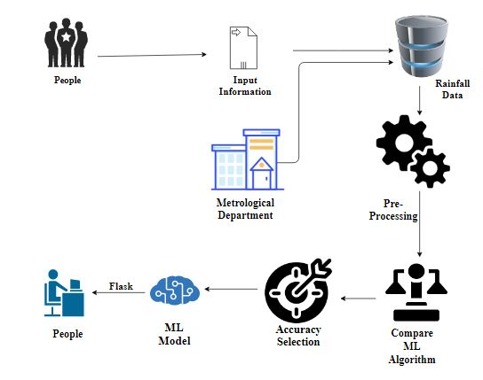
System Architecture:

Slide 15
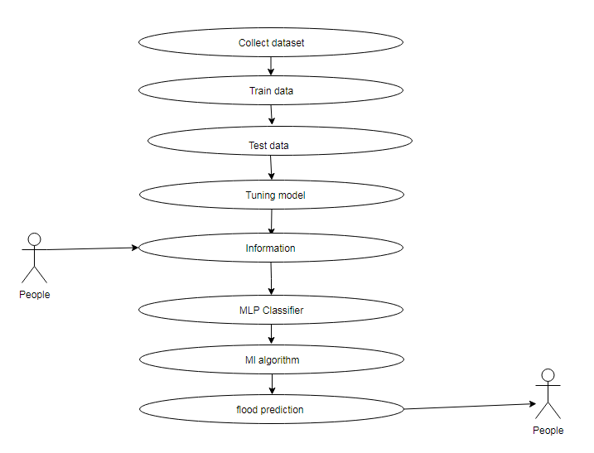
Use case Diagram:

Slide 16
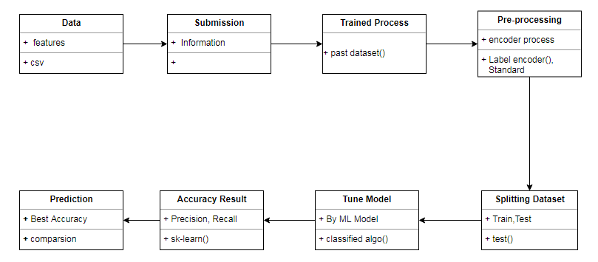
Class Diagram:

Slide 17
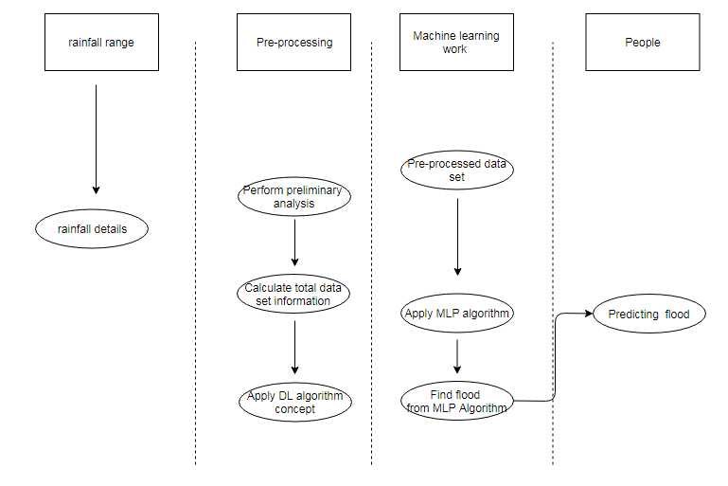
Activity Diagram:

Slide 18
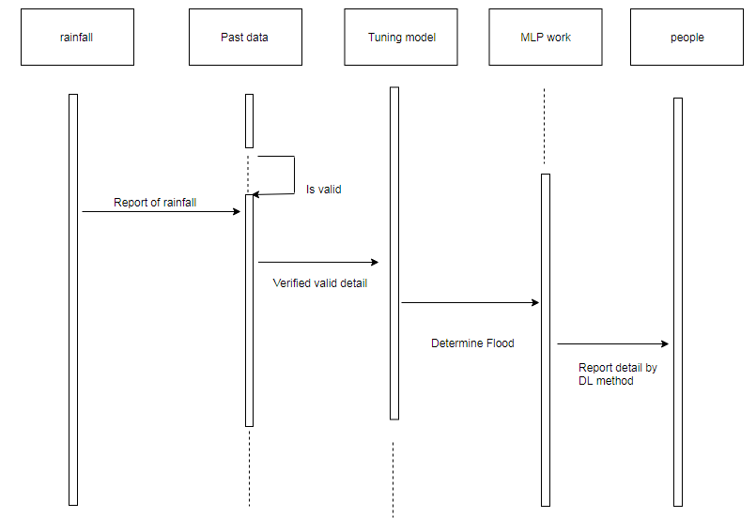
Sequence Diagram:

Slide 19
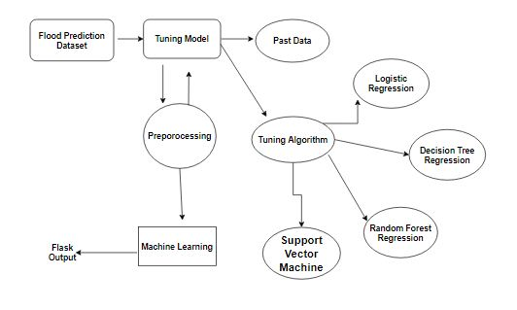
ER Diagram:

Slide 20
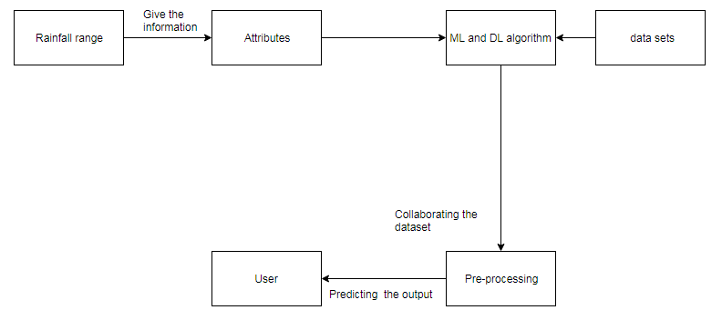
Collaboration Diagram:

Slide 21
Conclusion:
The analytical process started from data cleaning and processing, missing value, exploratory analysis and finally model building and evaluation. Finally we predict the flash flood using machine learning algorithm with different results. So, the best result is MLP algorithm (97.40%). This brings some of the following insights about flood prediction.
Future Work:
Disaster management wants to automate the detecting the flash flood happened or not from eligibility process (real time).
To automate this process by show the prediction result in web application or desktop application.
To optimize the work to implement in Artificial Intelligence environment.

